Slide 1
CREATING AN EMPLOYEE PERFORMANCE SCORECARD IN EXCEL

Slide 2
Advantages of Using an Excel-Based Rating System
Ease of Use: Excel’s intuitive interface simplifies data entry and analysis, making performance evaluations straightforward and hassle-free. Customization: The Excel-based system allows for flexible adaptations, ensuring it can be tailored to fit the unique requirements of any organization. Cost-Effectiveness: By utilizing the already familiar Excel platform, organizations save on the expense of specialized software, making it an economical choice for performance management.

Slide 3
Key Features of Employee Performance Rating Card and Dashboard
Average Performance Score by Supervisor: First chart we have created for Average Performance Score by Supervisor. This is doughnut chart wherein we are showing the Supervisor wise Average Performance score. In the center of the doughnut hole, we are showing the Average Performance score for all employees. Average Rating by Supervisor: This is second chart, we have created for Average Rating by Supervisor. This is again a doughnut chart wherein we are showing the Supervisor wise Average Rating. In the center of the doughnut hole, we are showing the Average Rating for all employees.

Slide 4
Features of these PowerPoint presentation slides:
Deliver this complete deck to your team members and other collaborators. Encompassed with stylized slides presenting various concepts, this Employee Performance Scorecard Powerpoint Presentation Slides is the best tool you can utilize. Personalize its content and graphics to make it unique and thought-provoking. All the thirty slides are editable and modifiable, so feel free to adjust them to your business setting. The font, color, and other components also come in an editable format making this PPT design the best choice for your next presentation

Slide 5
Content of this Powerpoint Presentation
Slide 1: This slide displays title i.e. ‘Employee Scorecard’. Slide 2: This slide presents Two Year Employee Engagement Comparison Scorecard. Slide 3: This slide exhibits Employee Weekly Calls Scorecard with Targets Achieved. Slide 4: This slide showcases Employee Competencies Scorecard with Rating and Track Record. Slide 5: This slide depicts Employee Daily Task Scorecard with Targets. Slide 6: This slide highlights Employee Behavior Scorecard with Self Assessment. Slide 7: This slide illustrates Employee Performance Scorecard for Job Promotion. Slide 8: This slide shows Sales Employee Monthly Scorecard with Target.

Slide 6
Labeling columns
Charts have several kinds of labels, such as tick labels, legend labels, and labels in the tooltips. In this section, we’ll see how to put labels inside (or near) the columns in a column chart. Let’s say we wanted to annotate each column with the appropriate chemical symbol. We can do that with the annotation role:

Slide 7
Control the visibility of data values
Similar scenario can occur for a Bubble chart as well. We cannot calculate the height of a bubble chart so a new attribute minRadiusForValue has been introduced where u can specify the minimum radius of the bubble to display the data values of the plots.

Slide 8
Customize Data Value Border
Specify the hex code of the border color using the valueBorderColor attribute. Set the transparency of the border using the valueBorderAlpha attribute. Set the thickness of the border using the valueBorderThickness attribute. Set the radius if the border using the valueBorderRadius attribute. Set the valueBorderDashed attribute to 1 to display the border as dashed lines. Specify the gap between two dashed lines using the valueBorderDashGap attribute.

Slide 9
Main Elements of Scorecards & Dashboards
Display Manager – A small configuration program. used to select the display’s parameters such as captions, type of chart or graph, minimum/maximum values, data source, color codes and others. Data Manager – A small configuration program used to select the display’s parameters such as captions, type of chart or graph, minimum/maximum values, data source, color codes and others.

Slide 10
Customize Data Value Background
Specify the hex code of the border color using the valueBorderColor attribute. Set the transparency of the border using the valueBorderAlpha attribute. Set the thickness of the border using the valueBorderThickness attribute. Set the radius if the border using the valueBorderRadius attribute. Set the valueBorderDashed attribute to 1 to display the border as dashed lines. Specify the gap between two dashed lines using the valueBorderDashGap attribute. Set the length of each dash using the valueBorderDashLen attribute.

Slide 11
Customizing a visualization
View a visualization in an Explore, or edit a visualization in a Look or dashboard. Open the Edit menu in the visualization. Click the Edit Chart Config button in the Plot tab. Looker displays the Edit Chart Config dialog. The Chart Config (Source) pane contains the original JSON of your visualization and cannot be edited. The Chart Config (Override) pane contains the JSON that should override the source JSON. When you first open the Edit Chart Config dialog, Looker populates the pane with some default JSON. You can start with this JSON, or you can delete this JSON and enter any valid HighCharts JSON.

Slide 12
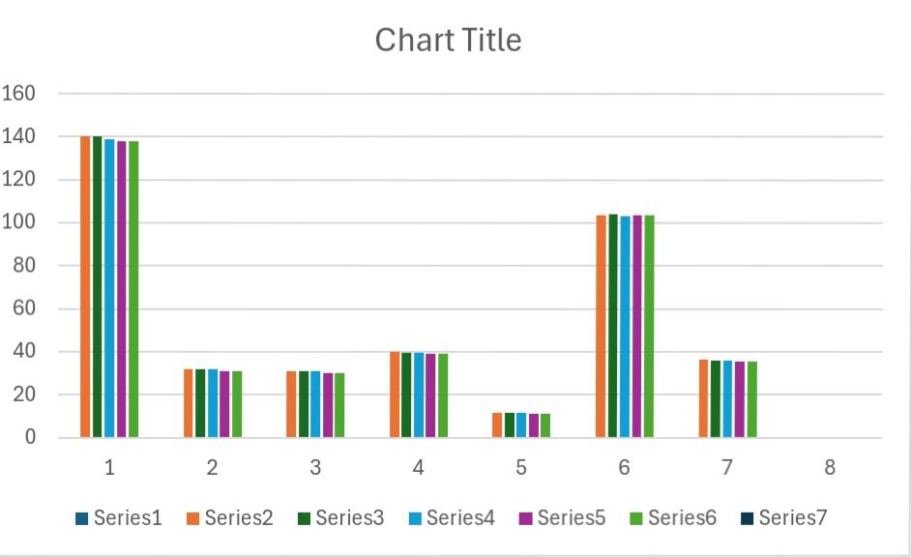
Result

Slide 13
THANK YOU

